Slide 1

The Science Lab/Classroom

Slide 2


Area of Focus: Lab Reports
You will be learning to write lab reports for each lab assigned in class. These are due the next COACH class following the assigned lab.
USE NOTEBOOK PAPER FOR YOUR LAB REPORTS. Please make notes legible and use indentations when appropriate.
Include diagrams, charts, etc.

Slide 3
Make visuals clear and well drawn. Please label like the example below:
Convex Lens
Focal Point
Focal Length

Slide 4
Do not label like this:
Convex Lens
Focal Point
Not like this…
Focal Length

Slide 5
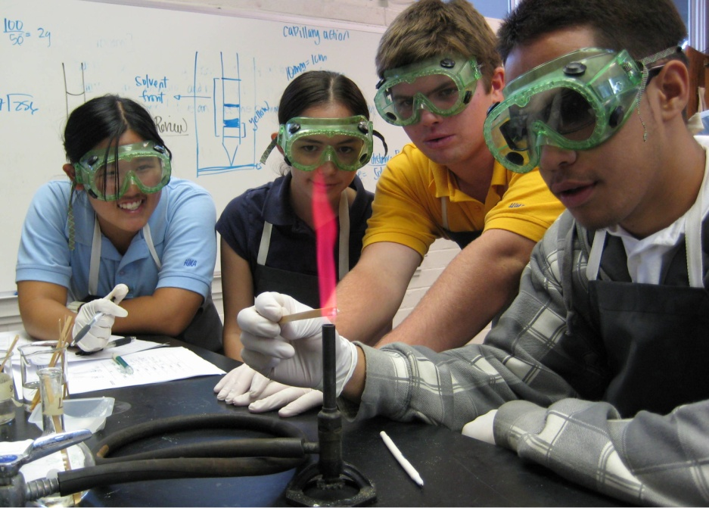
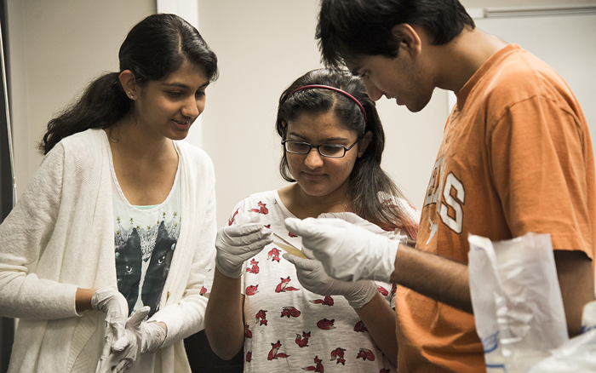
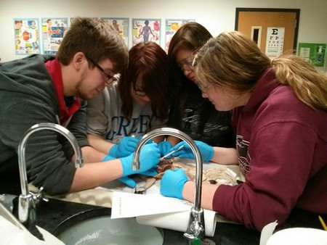

Area of Focus: Lab Safety.
Copyright © 2010 Ryan P. Murphy

Slide 6

Studying science can be a lot of fun, but it can also be dangerous unless some common lab safety procedures are followed.
This is the product of Ryan P. Murphy Copyright 2010
www.sciencepowerpoint.com
Copyright © 2010 Ryan P. Murphy

Slide 7

Here are a few lab safety rules that should be followed:
“Lab Safety is no joke, so pay attention and use common sense.”
Copyright © 2010 Ryan P. Murphy

Slide 8

A safety quiz follows this short presentation.
Copyright © 2010 Ryan P. Murphy

Slide 9
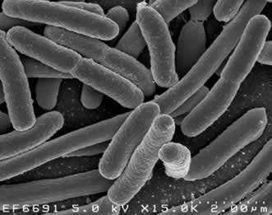
Handle everything as if it's pathogenic.
  Pathogenic means that what you are handling could be an infective agent that could cause disease.
  Clean work station, as needed, with proper disinfectant. Clean station @ end of each lab time.
Copyright © 2010 Ryan P. Murphy

Slide 10
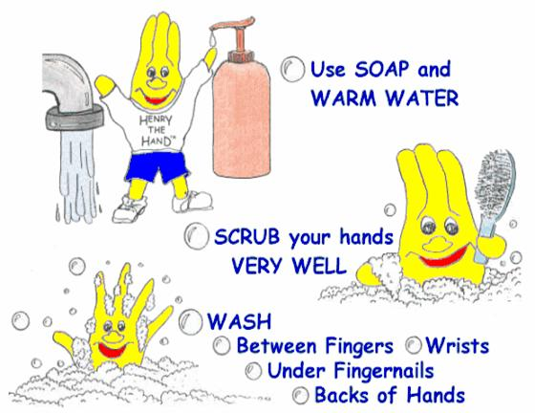
Stop sharing your germs!
The #1 way to prevent the spread of infection is:
HANDWASHING!!!
FRICTION
IS MOST IMPORTANT
15-20 seconds
Notes:
Antibacterial hand foam do NOT work alone! They do NOT kill all germs…need an Autoclave @ 200+ degrees! Friction /scrubbing for 15-20 seconds is the most important step in handwashing!

Slide 11
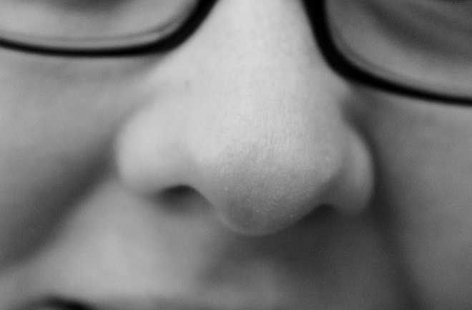
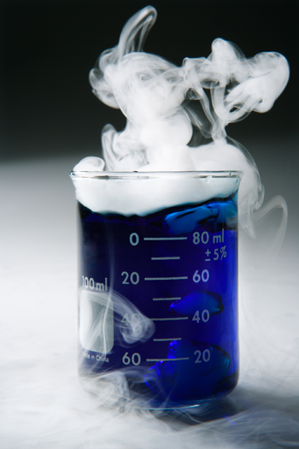
Do not breathe vapors or put anything close to your nose to smell unless instructed.
  When smelling, do not hold the object below your nose
Copyright © 2010 Ryan P. Murphy

Slide 12
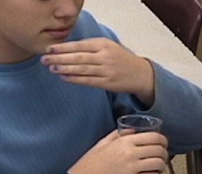
Do not breathe vapors or put anything close to your nose to smell unless instructed.
  When smelling, do not hold the object below your nose, waft the fumes toward you with your hand.
Copyright © 2010 Ryan P. Murphy

Slide 13

Avoid blood and other bodily fluid.
  If you are bleeding then please contact teacher immediately to get wound cleaned and covered.

Slide 14

Please check glassware for cracks or chips prior to use.
  If glassware is broken please contact teacher promptly!
Copyright © 2010 Ryan P. Murphy

Slide 15

Clean spills from the outside in.
  Apply paper towels over the spill, then, carefully starting from the outside, wipe in.
Copyright © 2010 Ryan P. Murphy

Slide 16


Please do not eat food or drink in the classroom.
  No gum.
  Cough drops unless prescribed.
  Or putting strange things in your mouth.
Copyright © 2010 Ryan P. Murphy

Slide 17

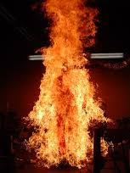
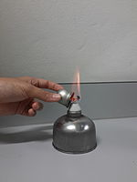
Keep flammable solutions away from flame.
Copyright © 2010 Ryan P. Murphy

Slide 18
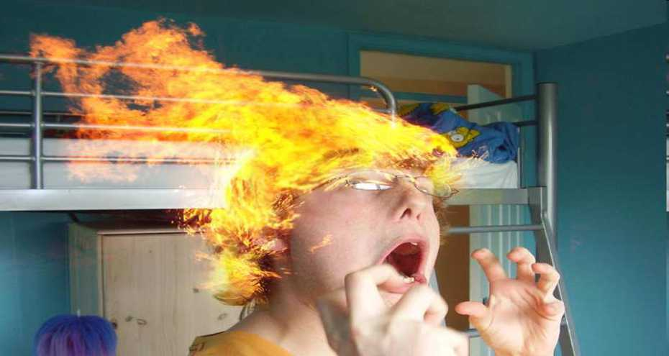
If you have long hair, please tie it back so that it will not hang down and catch on fire on lab days.
Copyright © 2010 Ryan P. Murphy

Slide 19

Know where the fire extinguisher is and how to use it.
  We have a Carbon Dioxide all purpose fire extinguisher.
    P = pull the ring pin
    A = aim at the base of the fire
    S = squeeze the trigger
    S = sweep back & forth
Copyright © 2010 Ryan P. Murphy

Slide 20
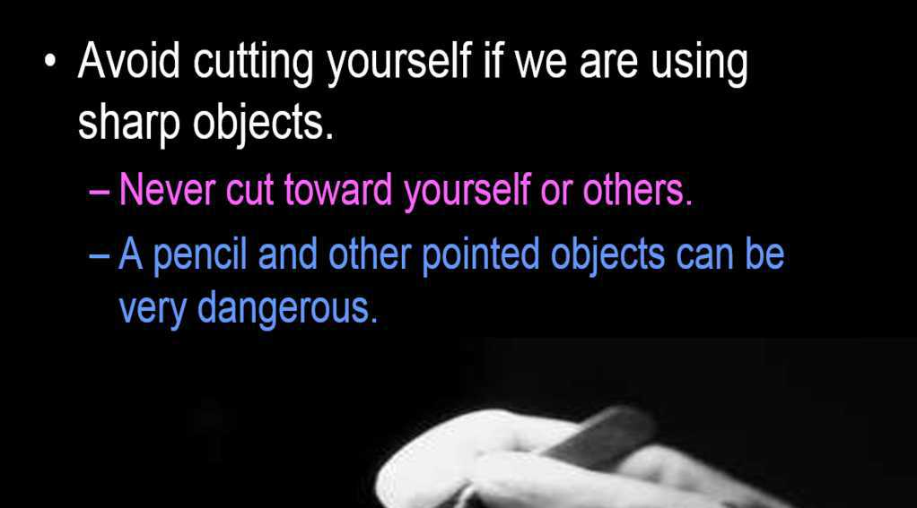
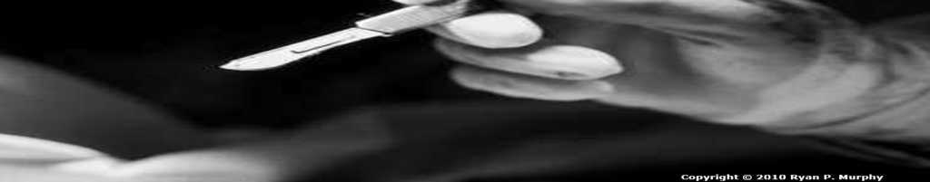

Slide 21

Use common sense at all times.
  No horseplay.
  No pushing.
  No running.
  No squirting with droppers.
  No throwing things.
  Basically use common sense.

Slide 22
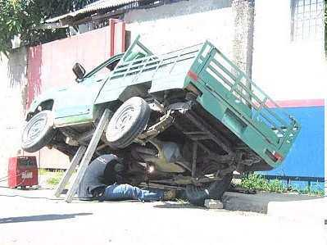
Use common sense at all times.

Slide 23
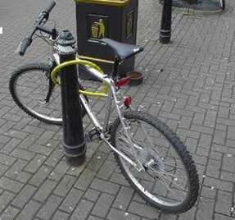

Slide 24
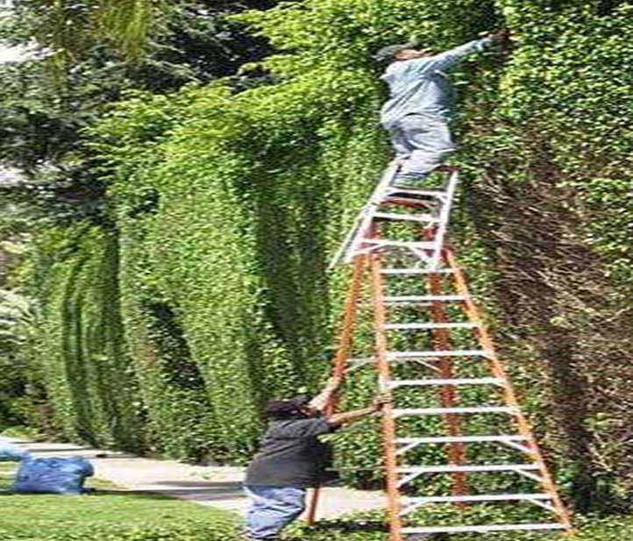

Slide 25

Lab Safety Quiz
For all assignments, please write on the paper as follows: (Top right corner)
Name
    Class
Date
Write title of paper (ie: Safety Quiz) on top line of page
Write numbers for answers as directed along left side of page
Work independently, with no wandering eyes

Slide 26
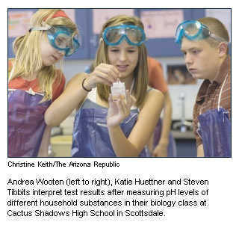
# 1. Which of the students is being unsafe in the lab and will require talking to?
A
B
C

Slide 27
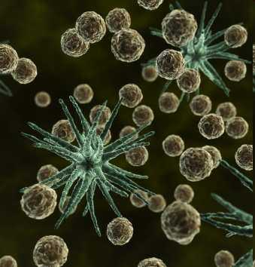
#2.) You should treat everything as if it pathogenic means…
  A.) It is okay to touch and taste lab materials.
  B.) You should place materials directly under your nose to make sure they are safe.
  C.) Keep a clean work station and do everything possible to avoid contact with pathogens.
  D.) Pathogenic refers to the emergency exit that connects to the adjacent room.

Slide 28

#2) If you break glassware or see chipped /cracked glassware.
  A.) Don’t say anything because you will get in trouble.
  B.) Report broken glassware to the teacher so it can be safely removed and the area cleaned.
  C.) Use the cracked glassware for today’s lab and then alert the teacher.
  D.) Blame your lab partner and then make up lies.
Copyright © 2010 Ryan P. Murphy

Slide 29
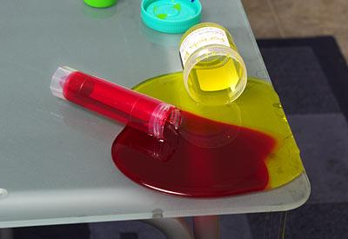
#4.) If you spot bodily fluid in the room you should?
  A.) Stay away from it and alert the teacher so that he / she can clean the area.
  B.) Immediately assist the injured by applying pressure to the wound with your hand.
  C.) Get some paper towels to clean the area immediately.
  D.) Don’t interrupt the lesson, wait for a good time near the end of the class.
Copyright © 2010 Ryan P. Murphy

Slide 30
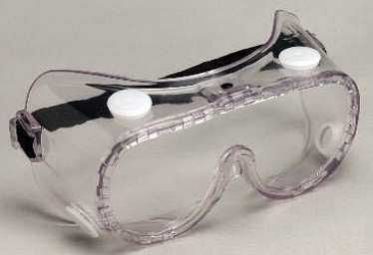
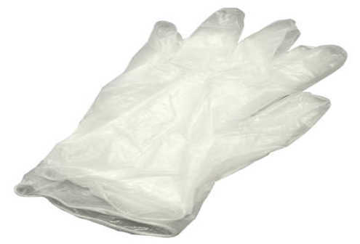
#5.) Do NOT bring ________ or _________ into the lab.
  A.) Pens and Pencils.
  B.) Goggles and gloves.
  C.) Food and Drink.
  D.) Commonsense and a safe attitude.
Copyright © 2010 Ryan P. Murphy

Slide 31
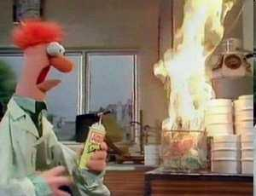
#6.) This happened because…
  A.) Spontaneous combustion.
  B.) Flammable materials were not set away from the flame.
  C.) Increase in the Friction Coefficient.
  D.) Muppets are silly.
Copyright © 2010 Ryan P. Murphy

Slide 32
#7. This lab report illustration is incorrect because:
  The only color to use is blue
  The labels are hard to read
  There is a lot of misspelled words
  No drawings allowed, only photos
Convex Lens
Focal Point
Focal Length

Slide 33
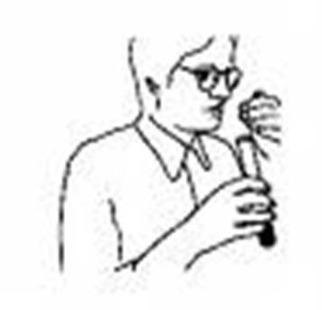
#8.Inhale fumes ONLY by:
Breathing deeply over the fumes
Go into a closet and inhale
Waft with your hand
Stand in front of a fan

Slide 34

Quiz is over!
Please Turn your
answer sheet
into The teacher

